Slide 1



Slide 2
Introduction to simple git
What it is and using for yourself.

Slide 3
Where we are going …
Start a repository
Set-up your details
Check the status and history
Add a file to version control (staging)
Commit the changes (a version)
Compare
Checkout
Making a branch
Sharing with a remote repository

Slide 4
1. Setting up a repository
Create a new project in a directory (folder) for projects.
Create a new folder (or use your existing one) for projects
Somewhere convenient for you
Create a new project in that folder
Call it anything you like
Create a git repository

Slide 5
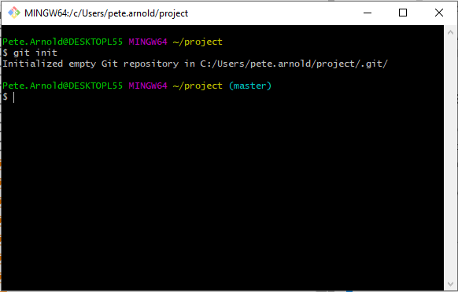
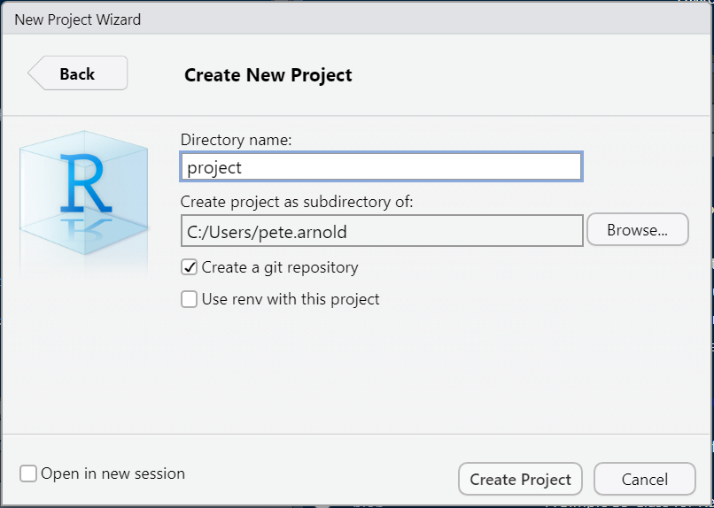
1. Setting up a repository

Slide 6
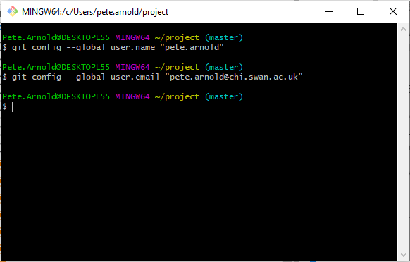
2. Set-up your details

Slide 7
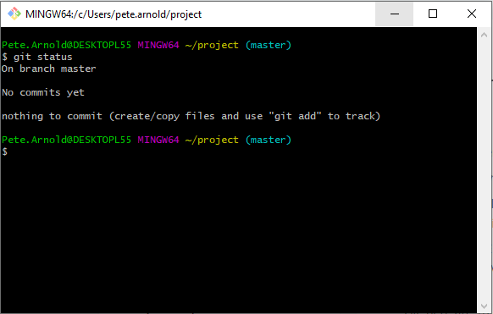
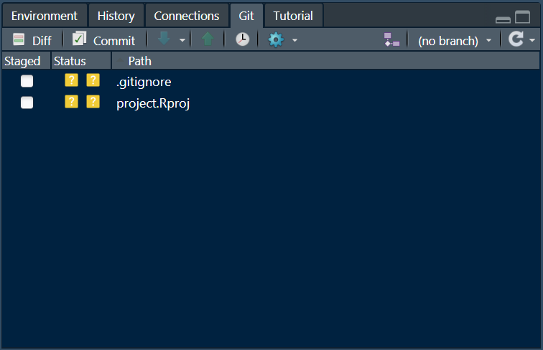
3. Check the project status

Slide 8
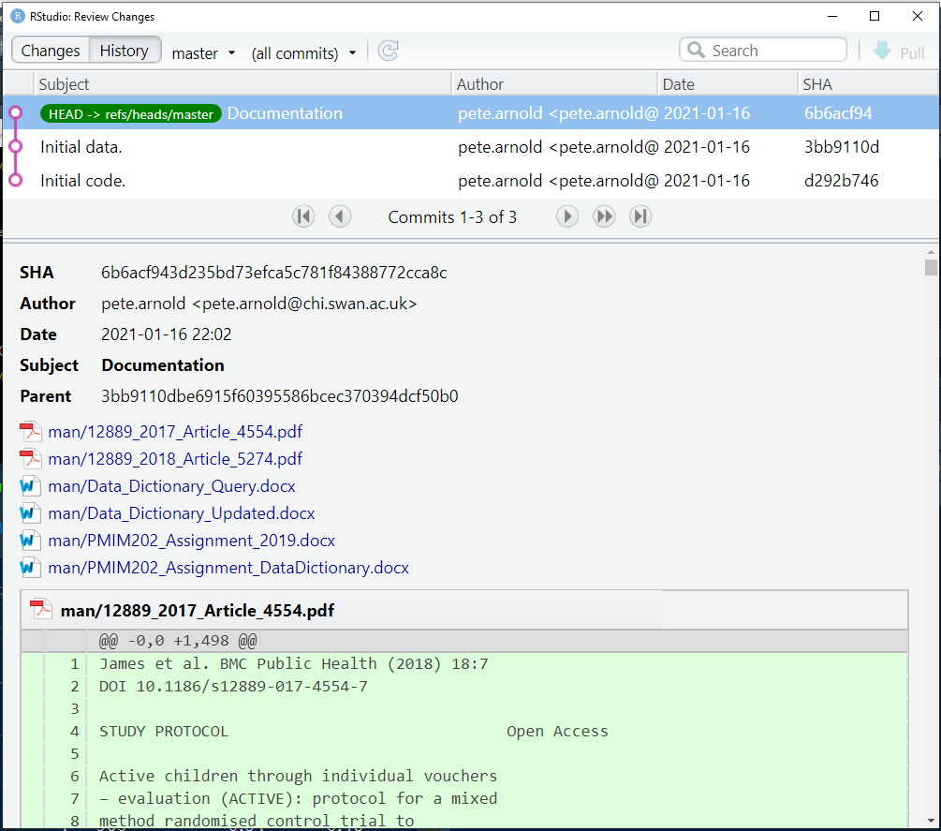
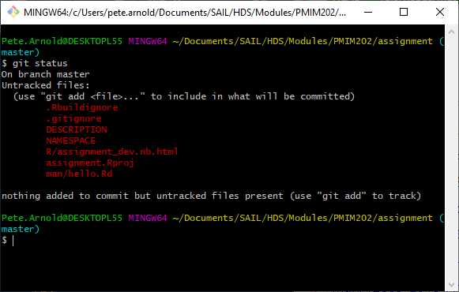
3. Check the project status

Slide 9
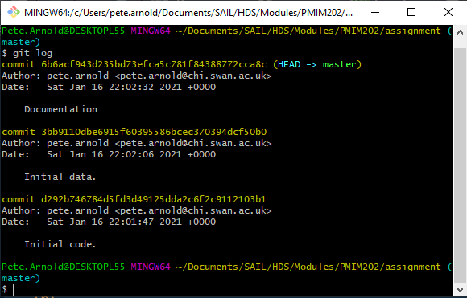
3. Check the project history

Slide 10
4. Add a file (or 2) to version control (staging)
Create a couple of new R Script (or Markdown) files.
New file menu
Add some test code, e.g.
x <- 10; y <- 7
z <- sqrt(x)
cat("The square root of ", x, " is ", z, ".\n")
Save the files

Slide 11
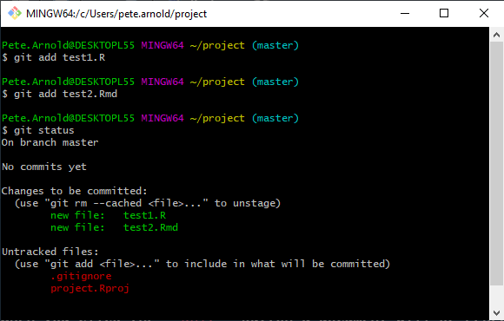
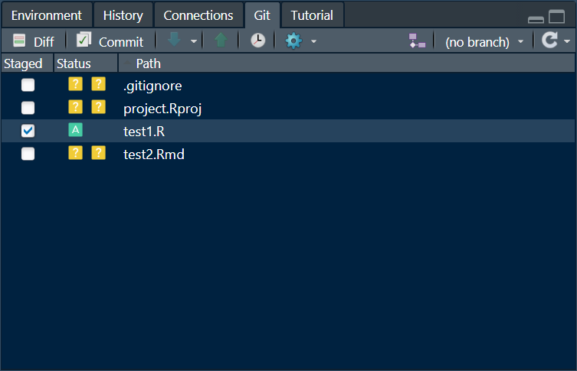
4. Add a file (or 2) to version control (staging)

Slide 12
4. Or remove to version control (staging)
To remove a file
git rm test1.R
To unstage a file
git rm --cached test1.R

Slide 13
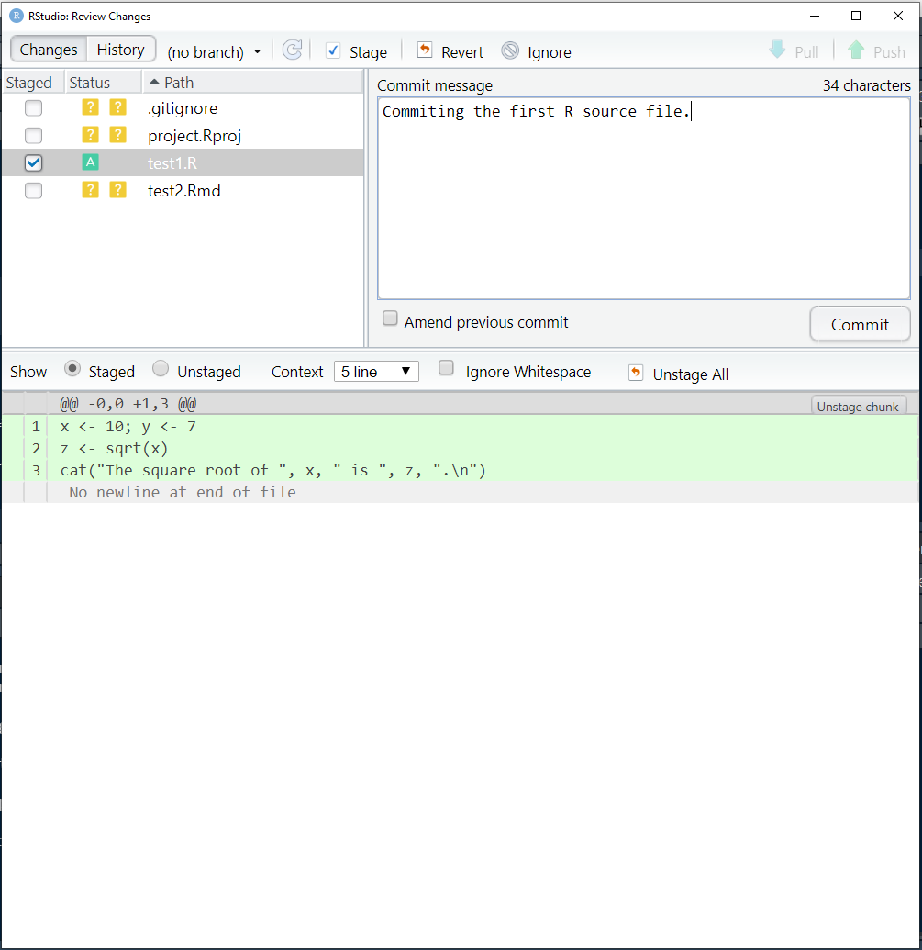

5. Commit the changes (a version)

Slide 14
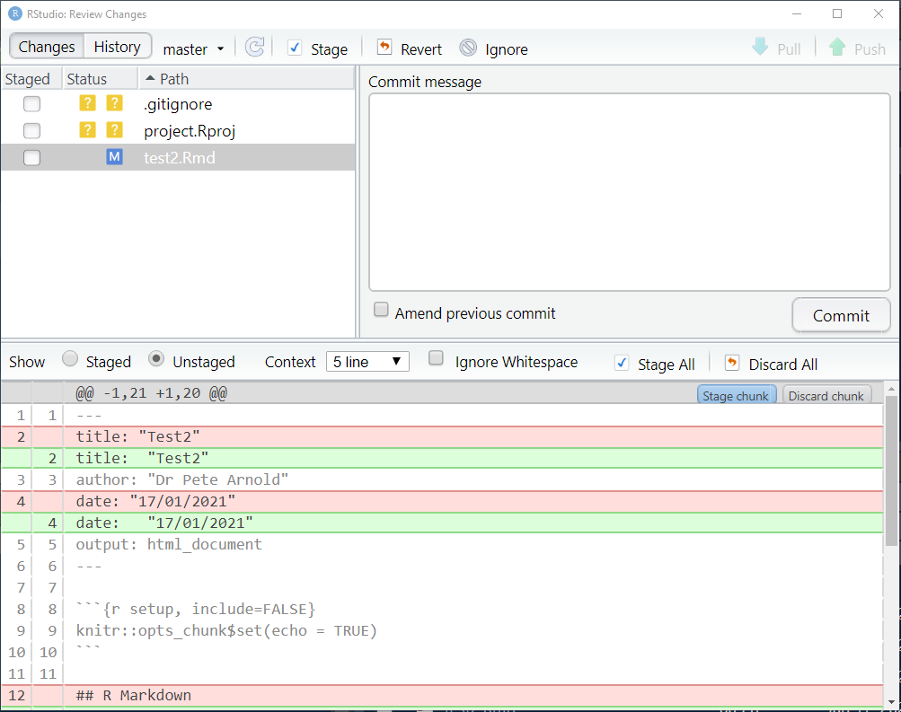
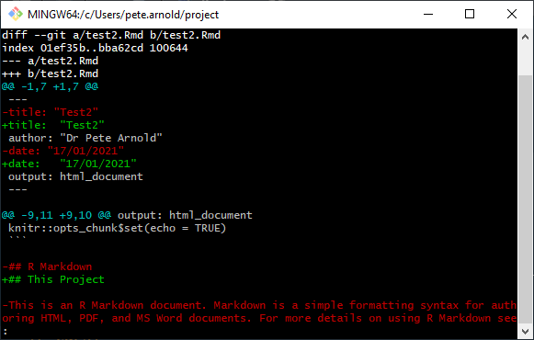
6. Compare (diff)

Slide 15
Exercise: make some changes and commit
Have a look at the log
Make some changes to the files, check status, stage and commit
Repeat several times
Add a new file, stage and commit

Slide 16
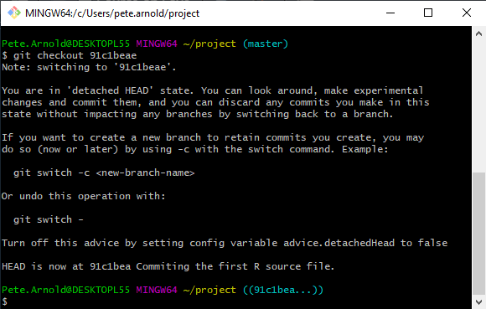
7. Change the working version (checkout)
Have a look at the log
Decide which version you want
Make a note of the SHA (e.g. 91c1beae)
Use bash only:
git checkout 91c1beae
This is a temporary detached version
Create a branch if you want to work
git checkout master

Slide 17
Exercise: Try some checkouts
Go back to the master version with:
git checkout master
Try checking out a couple of versions and back to the master
Note that all the files changes to that version, files that do not exist in that version disappear.

Slide 18
8. Making a branch (checkout)
Checking out to work involves creating a branch
You name the branch (like master, master is a branch)
You can save changes on a branch using commit
git checkout 91c1beae -b updates_to_paper
Or use the new branch button in R-studio's git panel.

Slide 19
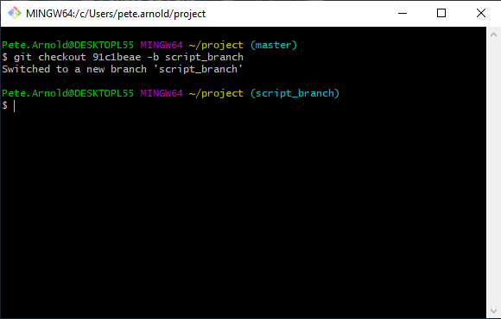
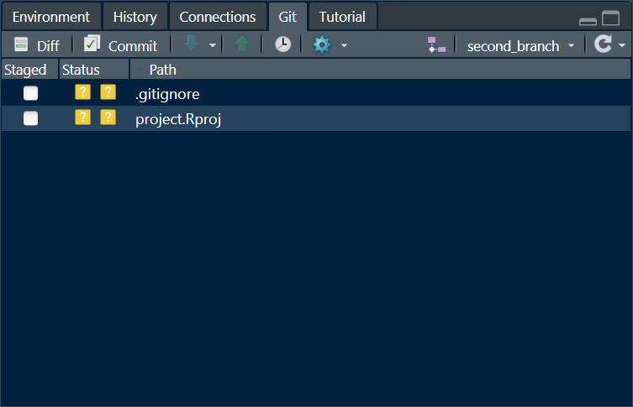
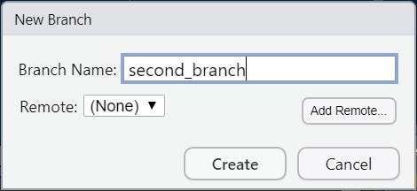
8. Making a branch (checkout)

Slide 20
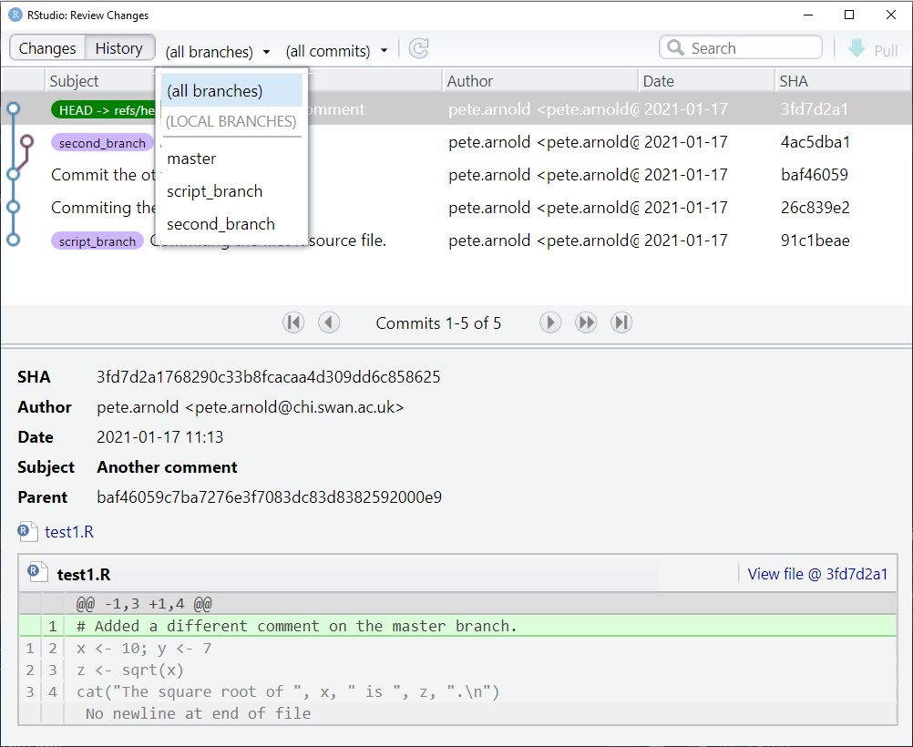
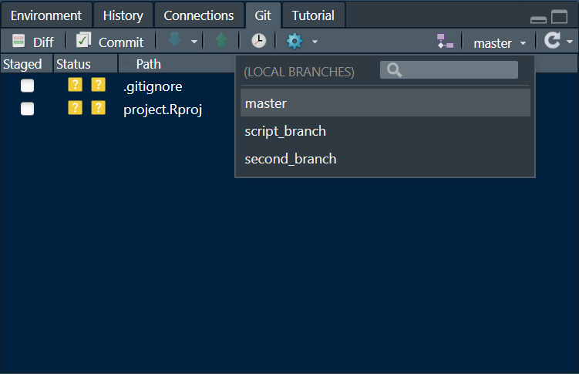
8. Making a branch (checkout)

Slide 21
Exercise: Branching
Check out an old version as a branch.
Make changes to the code and commit (do this a couple of times).
Check out the master.
Explore the log and branches lists.
Make changes to the (master) code and commit (do this a couple of times).
Repeat (1 - 5) to get used to the process.

Slide 22
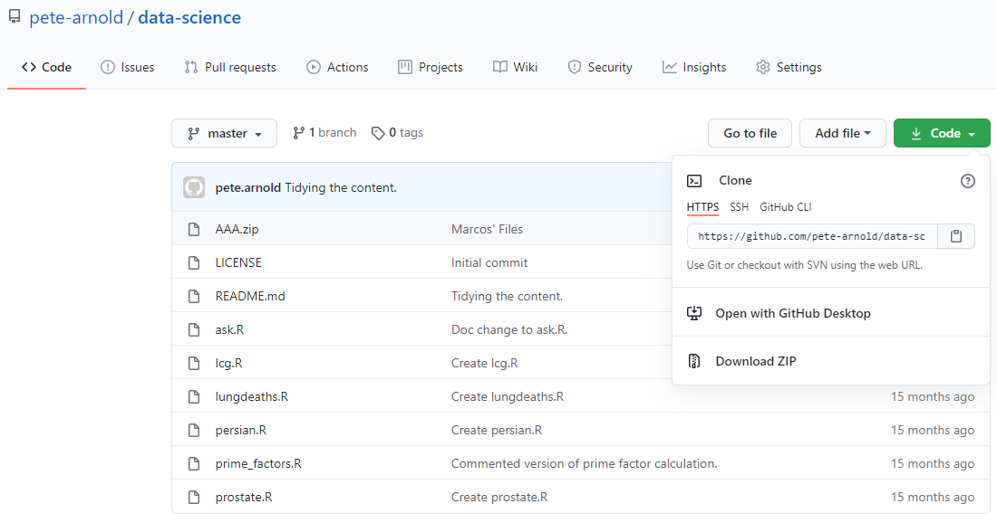
9. Sharing with a remote

Slide 23
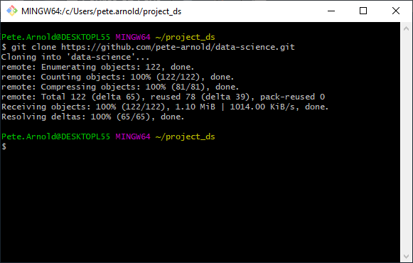
9. Sharing with a remote
Go to github.com
Find a repository
e.g. pete-arnold/data-science
Find the repository URL
Clone the repository to a project directory
Create a project in an existing directory

Slide 24
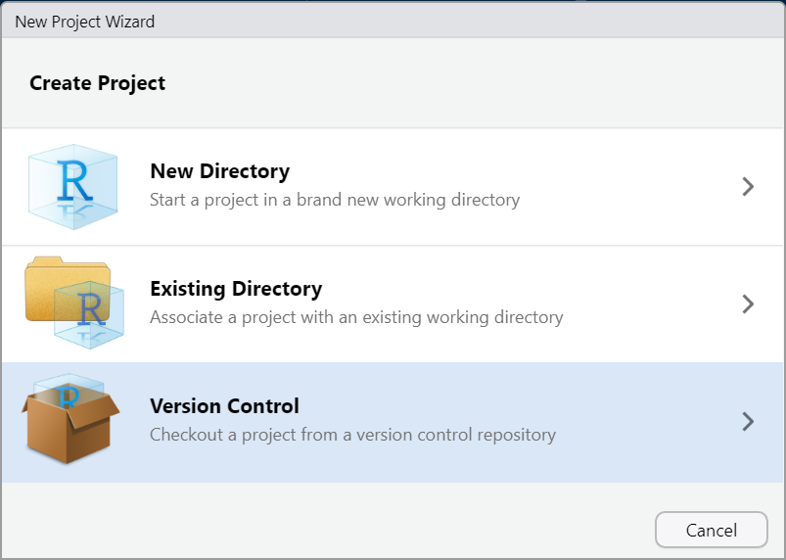
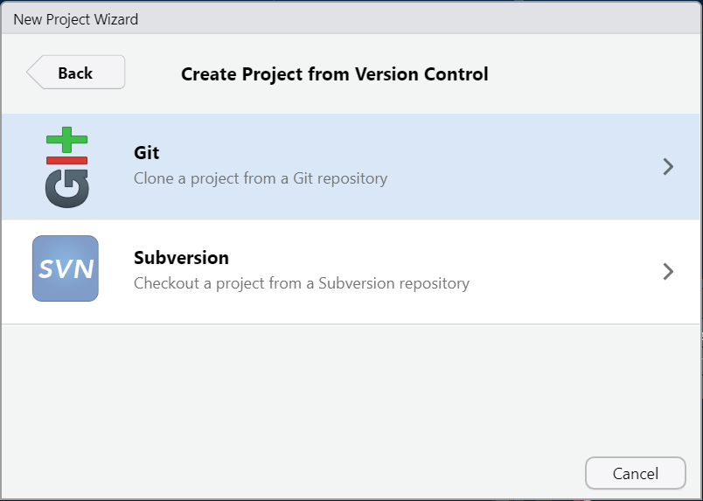
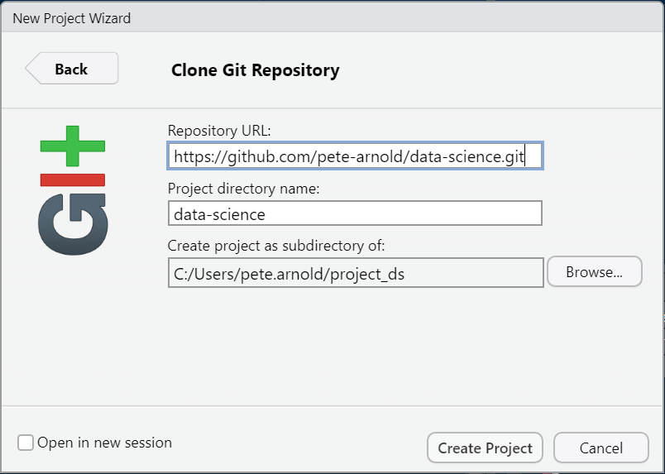
9. Sharing with a remote

Slide 25
Any questions?
Go to github.com and get an account.
Send me your account name and I will permit access.
Find the repository:
pete-arnold/data-science
Create a project and look at the code.

